Slide 1
CS3081: “Artificial Intelligence”
Knowledge Representation
Logic
Prof Passent Elkafrawy
pelkafrawy@effatuniversity.edu.sa
CoE112, ext 7896

Slide 2
Reading R&N
Chapter 8 First-order logic
.
The slides were inspired from:
Adapted from Stuart Russell and Dawn Song UC, Berkeley (credits: ai.berkeley.edu)

Slide 3
First-Order Logic
Propositional logic assumes the world contains facts.
Propositional logic has very limited expressive power (unlike natural language)
e.g., cannot say pits cause breezes in adjacent squares ””, except by writing one sentence for each square
First Order Logic (like natural language) assumes the world contains:
Objects: people, houses, numbers, colors, baseball games, wars, …
Relations: red, round, prime, brother of, bigger than, part of, comes between, …
Functions: father of, best friend, one more than, plus, …

Slide 4
Examples
One plus two equals three
Objects?
Relations?
Functions?
Squares neighboring the wumpus are smelly
Objects?
Relations?
Functions?

Slide 5
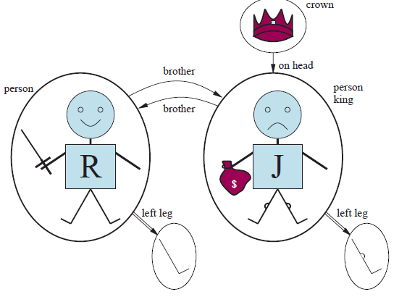
Models for FOL: Example

Slide 6
Syntax of FOL: Basic Elements
Constants KingJohn , 2 , QU, ...
Predicates Brother, >, …
Functions Sqrt , LeftLegOf , …
Variables x, y, a, b , …
Connectives ¬, ∧, ∨, ⇒, ⇔
Equality =
Quantifiers ∀, ∃

Slide 7
Terms and Atomic Sentences
Term = constant
or variable
or function (term1,… , term n)
Atomic sentence = predicate (term1,…, term n )
or term1 = term2
Examples:
Brother( KingJohn , RichardTheLionheart )
> ( LeftLegOf (Richard)), LeftLegOf KingJohn

Slide 8
Complex Sentences
Complex sentences are made from atomic sentences using connectives:
¬S, S1∧S2, S1∨S2, S1⇒S2,S1⇔S2
Examples:
Sibling( KingJohn,Richard ) ⇒ Sibling( Richard,KingJohn)
>(1,2 ) ∨ (1,2)
>(1,2) ∧ ¬ >(1,2)

Slide 9
Truth in FOL
Sentences are true with respect to a model and an interpretation.
Model contains objects (domain elements) and relations among them.
Interpretation specifies referents for
constant symbols → objects
predicate symbols → relations
function symbols → functional relations
An atomic sentence predicate(term 1 , ..., term n ) is true
iff the objects referred to by term 1 , ..., term n are in the relation referred to by predicate.

Slide 10
Universal Quantification
∀ <variables > <sentence>
∀ x P is true in a model m iff P is true with x being each possible object in the model.
Example: Everyone at EU is smart:
∀x At(x, EU) ⇒ Smart(x)
Roughly speaking, equivalent to the conjunction of instantiations of P
At (Manal, EU) ⇒ Smart (Manal)
∧ At (Malak, EU) ⇒ Smart (Malak)
∧ …

Slide 11
Common Mistake to Avoid
Typically ⇒ is the main connective with ∀
Common mistake: using ∧ as the main connective with ∀
∀x At(x, EU) ∧ Smart(x)
Means “Everyone is at EU and everyone is smart”

Slide 12
Existential Quantification
∃ <variables > <sentence>
∃ x P is true in a model m iff P is true with x being some possible object in the model.
Example: Someone at EU is smart:
∃ x At(x, EU) ∧ Smart(x)
Roughly speaking, equivalent to the disjunction of instantiations of P
At (Manal, EU) ∧ Smart (Manal)
∨ At (Malak, EU) ∧ Smart (Malak)
∨ …

Slide 13
Another Common Mistake to Avoid
Typically ∧ is the main connective with ∃
Common mistake: using ⇒ as the main connective with ∃
∃ x At(x, EU) ⇒ Smart(x)
Is true if there is anyone who is not at EU.

Slide 14
Fun with sentences
Everyone knows President Obama
∀n Person(n) ⇒ Knows(n,Obama)
There is someone that everyone knows
∃s Person(s) ∧ ∀n Person(n) ⇒ Knows(n,s)
Everyone knows someone
∀x Person(x) ⇒ ∃y Person(y) ∧ Knows(x,y)

Slide 15
More fun with sentences
Any two people of the same nationality speak a common language
Nationality(x,n) – x has nationality n
Speaks(x,l) – x speaks language l
∀x,y (∃ n Nationality(x,n) ∧ Nationality(y,n)) ⇒
(∃ l Speaks(x,l) ∧ Speaks(y,l))

Slide 16
Properties of Quantifiers
∀x ∀y is the same as ∀y ∀x
∃x ∃y is the same as ∃y ∃x
∃x ∀y is not the same as ∀y ∃x
∃x ∀y loves (x,y)
There is a person who loves everyone in the world
∀y ∃x loves (x,y)
Everyone in the in the world is loved by at least one person

Slide 17
Properties of Quantifiers
Quantifier duality: each can be expressed using the other:
∀x Likes (x, IceCream) ¬∃x ¬ Likes(x, IceCream)
∃x Likes(x, Brocoli) ¬∀x ¬ Likes(x, Brocoli)

Slide 18
Equality
term 1 = term 2 is true under a given interpretation if and only if term 1 and term 2 refer to the same object.
e.g ., definition of Sibling in terms of Parent:
∀x,y Sibling(x,y) [
¬(x = y)
∃m, f ¬ (m = f) Parent(m,x) ∧ Parent(f,x)
∧ Parent(m,y) ∧ Parent(f,y)
]

Slide 19
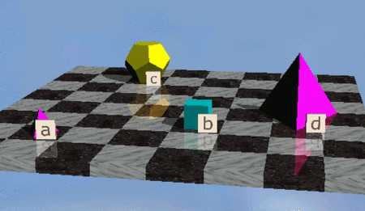
Using the FOL

Slide 20
The Kindship Domain
Brothers are siblings
∀x,y Brother(x,y) ⇔ Sibling(x,y)
Sibling ” is symmetric
∀x,y Sibling(x,y) ⇔ Sibling(y,x)
One's mother is one's female parent
∀m,c Mother(c) = m ⇔ (Female(m) ∧ Parent(m,c))
A cousin is a child of a parent’s sibling
∀x,y Cousin(x,y) ⇔ ∃ p, ps Parent(p,x) ∧ Parent(ps,y) ∧ Sibling(ps,p)

Slide 21
KB for The Wunpus World
Perception
∀ t,s,b Percet([s,b,Glitter],t) ⇒ Glitter(t)
Reflex
∀t Glitter(t) ⇒ BestAction(grab,t)
…

Slide 22
Deducing Hidden Properties
Properties of squares:
∀ x,y,a,b Adjacent ([x,y],[a,b]) ⇔ [a,b] {[x+1,y],[x-1,y],x,y+1],[x,y-1]}
∀ q,t At(Agent, q, t) Breeze(t) ⇒ Breezy(q)
Squares are breezy near a pit:
Diagnostic rule infer cause from effect
∀q Breezy(q) ⇒ ∃ r Adjacent (r, q) ∧ Pit(r)
Causal rule – infer effect from a cause
∀r Pit(r) ⇒ [∀ q Adjacent (r, q) ⇒ Breezy(q) ]

Slide 23
Interacting with FOL KBs
Suppose a wumpus world agent is using an FOL KB and perceives a smell and a breeze (but no glitter) at t= 5:
Tell (KB, Percept ([Smell , Breeze, None], 5)
Ask (KB, ∃a BestAction (a , 5)) (i.e ., does the KB entail some best action at t= 5
Answer: Yes, {a/Shoot} <- substitution (binding list)
Given a sentence S and a substitution σ , S σ denotes the result of plugging σ into S
E.g. S =Smarter(x,y) -- σ= {x/Hillary, y/Bill} -- Sσ= Smarter(Hillary,Bill)
Ask(KB, S) returns some/all σ such that KB╞ Sσ

Slide 24
Inference in FOL

Slide 25

Universal Instantiation (UI)
Every instantiation of a universally quantified sentence is entailed by it:
for any variable v and ground term g
Example: ∀ x King(x) ∧ Greedy(x) ⇒ Evil(x) yields:
King(John) ∧ Greedy(John) ⇒ Evil(John)
King(Richard) ∧ Greedy(Richard) ⇒ Evil(Richard) …
UI can be applied several times to add new sentences

Slide 26

Existential Instantiation (EI)
For any sentence α, variable v, and constant symbol k that does not appear elsewhere in the knowledge base
Example: ∃x Crown(x) ∧ OnHead(x, John) yields:
Crown(C1) ∧ OnHead(C1,John)
provided C1 is a new constant symbol (called a Skolem constant)
EI can be applied once to replace the existential sentence.

Slide 27
Reduction to Propositional Inference
Suppose the KB contains just the following:
∀ x King(x) ∧ Greedy(x) ⇒ Evil(x)
King(John)
Greedy(John)
Brother(Richard, John)
Instantiating the universal sentence in all possible ways, we have:
King(John) ∧ Greedy(John) ⇒ Evil(John)
King(Richard) ∧ Greedy(Richard) ⇒ Evil(Richard)
Greedy(John)
Brother(Richard, John)
The new KB is propositionalized. King(John) , Greedy(John), Evil(John), …

Slide 28
Problems with to Propositionalization
Idea: propositionalize KB and query, apply resolution, return result.
Propositionalization seems to generate lots of irrelevant sentences.
Exmple:
∀ x King(x) ∧ Greedy(x) ⇒ Evil(x)
King(John)
∀y Greedy(y)
Brother(Richard, John)
It seems obvious that Evil(John), but propositionalization produces lots of facts, such as Greedy (Richard ), that are irrelevant.

Slide 29
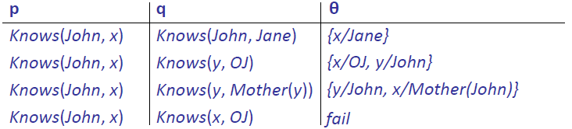
Unification
Finding substitutions that make different logical expressions look identical.
We can get the inference immediately if we can find a substitution θ such that King(x) and Greedy(y) match King(John) and Greedy(John)
θ= {x/John, y/John} works
Unify(α,β) = θ if αθ= βθ

Slide 30
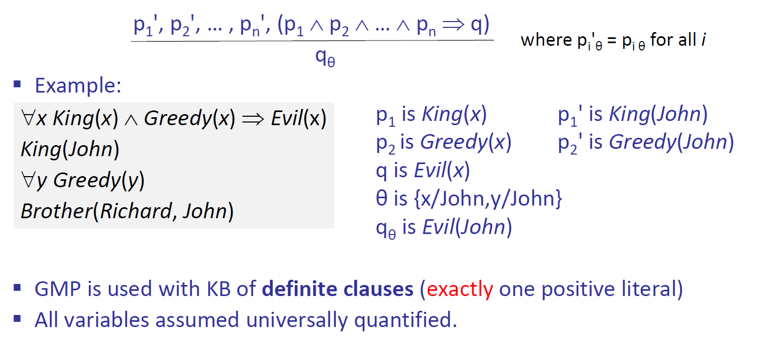
Generalized Modus Ponens (GMP)

Slide 31
Example KB
The law says that it is a crime for an American to sell weapons to hostile nations. The country Nono , an enemy of America, has some missiles, and all of its missiles were sold to it by Colonel West, who is American.
Prove that Colonel West is a criminal.

Slide 32
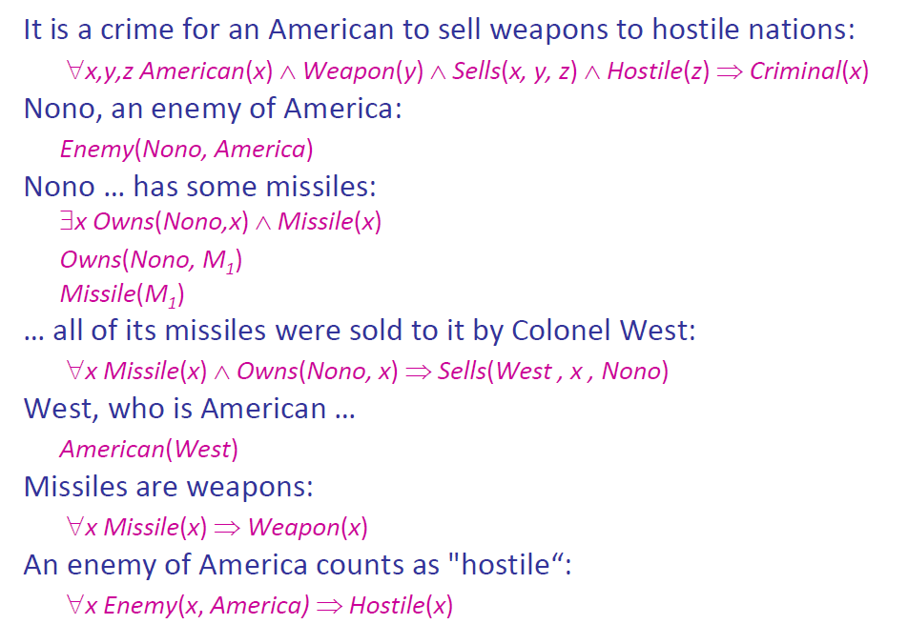
Example KB (cont.)

Slide 33
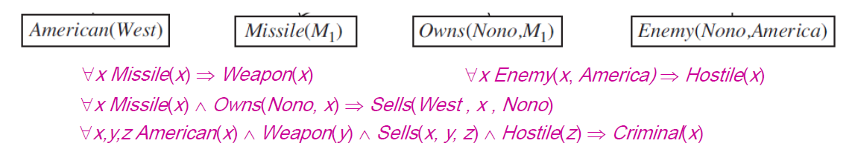
Forward Chaining Proof

Slide 34
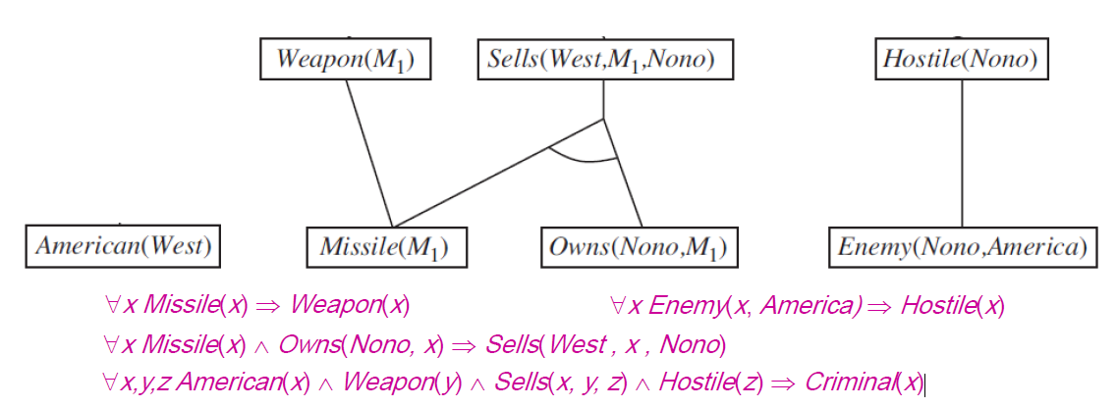
Forward Chaining Proof

Slide 35
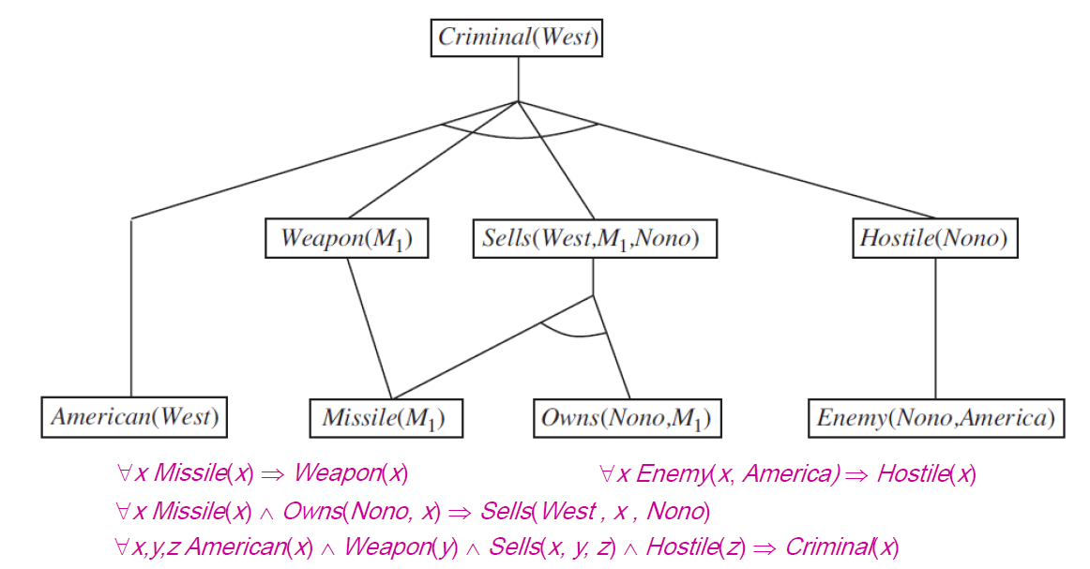
Forward Chaining Proof

Slide 36
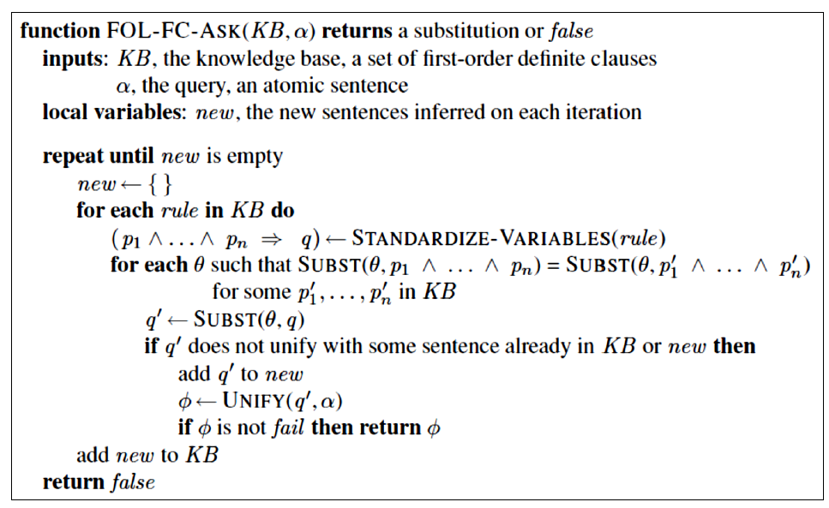
Forward Chaining Algorithm

Slide 37
Summary, pointers
FOL is a very expressive formal language
Many domains of common-sense and technical knowledge can be written in FOL (see AIMA Ch. 10)
circuits, software, planning, law, taxes, network and security protocols, product descriptions, ecommerce transactions, geographical information systems, Google Knowledge Graph, Semantic Web, etc.
Inference is semidecidable in general; many problems are efficiently solvable in practice

Slide 38
Truth in first-order logic
Sentences are true with respect to a model and an interpretation
Model contains ≥ 1 objects (domain elements) and relations among them Interpretation specifies referents for
constant symbols → objects predicate symbols → relations
function symbols → functional relations
An atomic sentence predicate(term₁, . . . , term_{n}) is true iff the objects referred to by term₁, . . . , term_{n} are in the relation referred to by predicate
© 2022 Pearson Education Ltd.

Slide 39
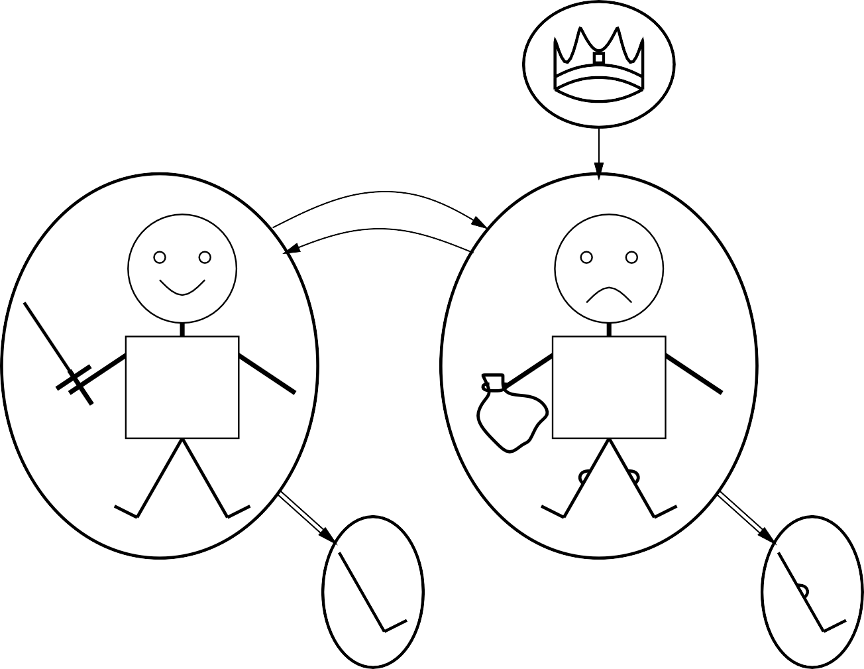
Models for FOL: Example
crown
brother
on head
person king
person
brother
R
J
$
left leg
left leg
© 2022 Pearson Education Ltd.

Slide 40
Truth example
Consider the interpretation in which Richard → Richard the Lionheart
John → the evil King John
Brother → the brotherhood relation
Under this interpretation, Brother(Richard, John) is true just in case Richard the Lionheart and the evil King John are in the brotherhood relation in the model.
© 2022 Pearson Education Ltd.

Slide 41
Models for FOL: Lots!
Entailment in propositional logic can be computed by enumerating models
We can enumerate the FOL models for a given KB vocabulary: For each number of domain elements n from 1 to ∞
For each k-ary predicate P_{k} in the vocabulary For each possible k-ary relation on n objects
For each constant symbol C in the vocabulary
For each choice of referent for C from n objects . . .
Computing entailment by enumerating FOL models is not easy!
© 2022 Pearson Education Ltd.

Slide 42
Universal quantification
∀ {variables } sentences
Everyone at Berkeley is smart:
∀ x At(x, Berkeley) ⇒ Smart(x)
∀ x P is true in a model m iff P is true with x being
each possible object in the model
Roughly speaking, equivalent to the conjunction of instantiations of P
(At(KingJ ohn, Berkeley)⇒ Smart(KingJ ohn))
∧ (At(Richard, Berkeley) ⇒ Smart(Richard))
∧ (At(Berkeley, Berkeley) ⇒ Smart(Berkeley))
∧ . . .
© 2022 Pearson Education Ltd.

Slide 43
A common mistake to avoid
Typically, ⇒ is the main connective with ∀
Common mistake: using ∧ as the main connective with ∀:
∀ x At(x, Berkeley) ∧ Smart(x)
means “Everyone is at Berkeley and everyone is smart”
© 2022 Pearson Education Ltd.

Slide 44
Existential quantification
∃ {variabless}sentences
Someone at Stanford is smart:
∃ x At(x, Stanford) ∧ Smart(x)
∃ x P is true in a model m iff P is true with x being
some possible object in the model
Roughly speaking, equivalent to the disjunction of instantiations of P
(At(KingJ ohn, Stanf ord) ∧ Smart(KingJ ohn))
∨ (At(Richard, Stanf ord) ∧ Smart(Richard))
∨ (At(Stanf ord, Stanf ord) ∧ Smart(Stanf ord))
∨ . . .
© 2022 Pearson Education Ltd.

Slide 45
Another common mistake to avoid
Typically, ∧ is the main connective with ∃
Common mistake: using ⇒ as the main connective with ∃:
∃ x At(x, Stanford) ⇒ Smart(x)
is true if there is anyone who is not at Stanford!
© 2022 Pearson Education Ltd.

Slide 46
Fun with sentences
Brothers are siblings
© 2022 Pearson Education Ltd.

Slide 47
Fun with sentences
Brothers are siblings
∀ x, y Brother(x, y) ⇒ Sibling(x, y). “Sibling” is symmetric
© 2022 Pearson Education Ltd.

Slide 48
Fun with sentences
Brothers are siblings
∀ x, y Brother(x, y) ⇒ Sibling(x, y). “Sibling” is symmetric
∀ x, y Sibling(x, y) ⇔ Sibling(y, x). One’s mother is one’s female parent
© 2022 Pearson Education Ltd.

Slide 49
Fun with sentences
Brothers are siblings
∀ x, y Brother(x, y) ⇒ Sibling(x, y). “Sibling” is symmetric
∀ x, y Sibling(x, y) ⇔ Sibling(y, x). One’s mother is one’s female parent
∀ x, y M other(x, y) ⇔ (F emale(x) ∧ Parent(x, y)). A first cousin is a child of a parent’s sibling
© 2022 Pearson Education Ltd.

Slide 50
Fun with sentences
Brothers are siblings
∀ x, y Brother(x, y) ⇒ Sibling(x, y). “Sibling” is symmetric
∀ x, y Sibling(x, y) ⇔ Sibling(y, x). One’s mother is one’s female parent
∀ x, y M other(x, y) ⇔ (F emale(x) ∧ Parent(x, y)). A first cousin is a child of a parent’s sibling
∀ x, y FirstCousin(x, y) ⇔ ∃ p, ps Parent(p, x) ∧ Sibling(ps, p) ∧
Parent(ps, y)
© 2022 Pearson Education Ltd.

Slide 51
Equality
term₁ = term₂ is true under a given interpretation
if and only if term₁ and term₂ refer to the same object
E.g., 1 = 2 and ∀ x ×(Sqrt(x), Sqrt(x)) = x are satisfiable
2 = 2 is valid
E.g., definition of (full) Sibling in terms of Parent:
∀ x, y Sibling(x, y) ⇔ [¬(x = y) ∧ ∃ m, f ¬(m = f ) ∧
Parent(m, x) ∧ Parent(f, x) ∧ Parent(m, y) ∧ Parent(f, y)]
© 2022 Pearson Education Ltd.

Slide 52
Interacting with FOL KBs
Suppose a wumpus-world agent is using an FOL KB
and perceives a smell and a breeze (but no glitter) at t = 5:
T ell(KB, P ercept([Smell, Breeze, N one], 5))
Ask(KB, ∃ a Action(a, 5))
I.e., does KB entail any particular actions at t = 5? Answer: Y es, {a/Shoot} ← substitution (binding list) Given a sentence S and a substitution σ,
Sσ denotes the result of plugging σ into S; e.g.,
S = Smarter(x, y)
σ = {x/Hillary, y/Bill}
Sσ = Smarter(Hillary, Bill)
Ask(KB, S) returns some/all σ such that KB |= Sσ
© 2022 Pearson Education Ltd.

Slide 53
Knowledge base for the wumpus world
“Perception”
∀ b, g, t P ercept([Smell, b, g], t) ⇒ Smelt(t)
∀ s, b, t P ercept([s, b, Glitter], t) ⇒ AtGold(t)
Reflex: ∀ t AtGold(t) ⇒ Action(Grab, t)
Reflex with internal state: do we have the gold already?
∀ t AtGold(t) ∧ ¬Holding(Gold, t) ⇒ Action(Grab, t)
Holding(Gold, t) cannot be observed
⇒ keeping track of change is essential
© 2022 Pearson Education Ltd.

Slide 54
Deducing hidden properties
Properties of locations:
∀ x, t At(Agent, x, t) ∧ Smelt(t) ⇒ Smelly(x)
∀ x, t At(Agent, x, t) ∧ Breeze(t) ⇒ Breezy(x)
Squares are breezy near a pit:
Diagnostic rule—infer cause from effect
∀ y Breezy(y) ⇒ ∃ x Pit(x) ∧ Adjacent (x, y)
Causal rule—infer effect from cause
∀ x, y Pit(x) ∧ Adjacent(x, y) ⇒ Breezy(y)
Neither of these is complete—e.g., the causal rule doesn’t say whether squares far away from pits can be breezy
Definition for the Breezy predicate:
∀ y Breezy(y) ⇔ [∃ x Pit(x) ∧ Adjacent(x, y)]
© 2022 Pearson Education Ltd.

Slide 55
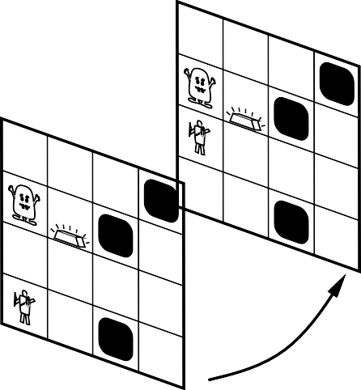
Keeping track of change
Facts hold in situations, rather than eternally
E.g., Holding(Gold, N ow) rather than just Holding(Gold)
Situation calculus is one way to represent change in FOL:
Adds a situation argument to each non-eternal predicate E.g., N ow in Holding(Gold, N ow) denotes a situation
Situations are connected by the Result function
Result(a, s) is the situation that results from doing a in s
PIT
Gold
PIT
PIT
PIT
Gold
PIT
S₁
PIT
Forward
S
0
© 2022 Pearson Education Ltd.

Slide 56
Describing actions I
“Effect” axiom—describe changes due to action
∀ s AtGold(s) ⇒ Holding(Gold, Result(Grab, s))
“Frame” axiom—describe non-changes due to action
∀ s HaveArrow(s) ⇒ HaveArrow(Result(Grab, s))
Frame problem: find an elegant way to handle non-change
representation—avoid frame axioms
inference—avoid repeated “copy-overs” to keep track of state
© 2022 Pearson Education Ltd.

Slide 57
Describing actions II
Successor-state axioms solve the representational frame problem
Each axiom is “about” a predicate (not an action per se):
P true afterwards
⇔ [an action made P true
∨ P true already and no action made P false]
For holding the gold:
∀ a, s Holding(Gold, Result(a, s)) ⇔
[(a = Grab ∧ AtGold(s))
∨ (Holding(Gold, s) ∧ a = Release)]
© 2022 Pearson Education Ltd.

Slide 58
Making plans
Initial condition in KB:
At(Agent, [1, 1], S₀)
At(Gold, [1, 2], S₀)
Query: Ask(KB, ∃ s Holding(Gold, s))
i.e., in what situation will I be holding the gold?
Answer: {s/Result(Grab, Result(F orward, S₀))}
i.e., go forward and then grab the gold
This assumes that the agent is interested in plans starting at S₀ and that S₀
is the only situation described in the KB
© 2022 Pearson Education Ltd.

Slide 59
Making plans: A better way
Represent plans as action sequences [a₁, a₂, . . . , a_{n}]
PlanResult(p, s) is the result of executing p in s
Then the query Ask(KB, ∃ p Holding(Gold, PlanResult(p, S₀)))
has the solution {p/[F orward, Grab]}
Definition of PlanResult in terms of Result:
∀ s PlanResult([ ], s) = s
∀ a, p, s PlanResult([a|p], s) = PlanResult(p, Result(a, s))
Planning systems are special-purpose reasoners designed to do this type of inference more efficiently than a general-purpose reasoner
© 2022 Pearson Education Ltd.

Slide 60
Knowledge Engineering in FOL
Knowledge engineering: the general process of knowledge-base construction.
The steps used in the knowledge engineering process:
Identify the questions.
Assemble the relevant knowledge
Decide on a vocabulary of predicates, functions, and constants
Encode general knowledge about the domain
Encode a description of the problem instance
Pose queries to the inference procedure and get answers
Debug and evaluate the knowledge base
© 2022 Pearson Education Ltd.

Slide 61
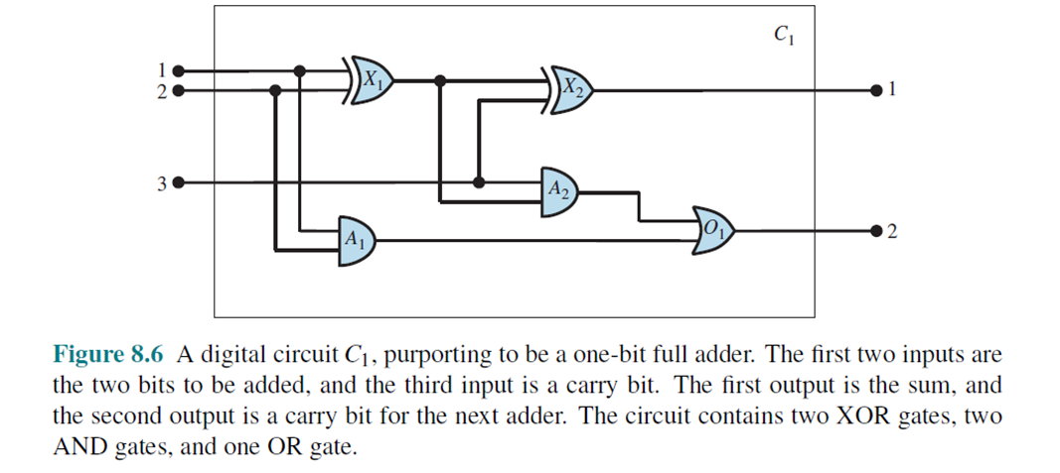
Knowledge Engineering in FOL
Applications in the electronic circuits domain
Identify the questions
Does the circuit in Figure 8.6 actually add properly?
If all the inputs are high, what is the output of gate A2?
Questions about the circuit’s structure are also interesting.
For example, what are all the gates connected to the first input terminal?
Does the circuit contain feedback loops?
© 2022 Pearson Education Ltd.

Slide 62
Knowledge Engineering in FOL
Applications in the electronic circuits domain
2. Assemble the relevant knowledge
Circuits composed of wires and gates.
Signals flow along wires to the input terminals of gates
Each gate produces a signal on the output terminal that flows along another wire.
There are four types of gates: AND, OR, and XOR gates have two input terminals, and NOT gates have one.
© 2022 Pearson Education Ltd.

Slide 63
Knowledge Engineering in FOL
Applications in the electronic circuits domain
3. Decide on a vocabulary
Each gate is represented as an object named by a constant, about which we assert that it is a gate with
Gate(X₁), eg: Type(X₁)=XOR
Circuit(C₁)
Terminal(x)
© 2022 Pearson Education Ltd.

Slide 64
Knowledge Engineering in FOL
Applications in the electronic circuits domain
4. Encode general knowledge of the domain
Example:
If two terminals are connected, then they have the same signal:
∀ t₁, t₂ Terminal(t₁) ∧ Terminal(t₂) ∧ Connected(t₁, t₂) ⇒
Signal(t₁)=Signal(t₂)
© 2022 Pearson Education Ltd.

Slide 65
Knowledge Engineering in FOL
Applications in the electronic circuits domain
5. Encode the specific problem instance
Categorize the circuit and its component gates & show the connections:
Connected(Out(1,X₁), In(1,X₂)) Connected(In(1,C₁); In(1,X₁))
© 2022 Pearson Education Ltd.

Slide 66
Knowledge Engineering in FOL
Applications in the electronic circuits domain
6. Pose queries to the inference procedure
What are the possible sets of values of all the terminals for the adder circuit?
This final query will return a complete input–output table for the device, which can be used
© 2022 Pearson Education Ltd.

Slide 67
Knowledge Engineering in FOL
Applications in the electronic circuits domain
7. Debug the knowledge base
We can perturb the knowledge base in various ways to see what kinds of erroneous behaviors emerge
Example if no assertion 1 ≠ 0
© 2022 Pearson Education Ltd.

Slide 68
Summary
First-order logic:
objects and relations are semantic primitives
syntax: constants, functions, predicates, equality, quantifiers
Increased expressive power: sufficient to define wumpus world
Situation calculus:
conventions for describing actions and change in FOL
can formulate planning as inference on a situation calculus KB
Developing a KB in FOL requires a careful process of analyzing the domain, choosing a vocabulary, and encoding the axioms required to support the desired inferences.
© 2022 Pearson Education Ltd.

